Slide 1
Project 3
Jason Feng

Slide 2
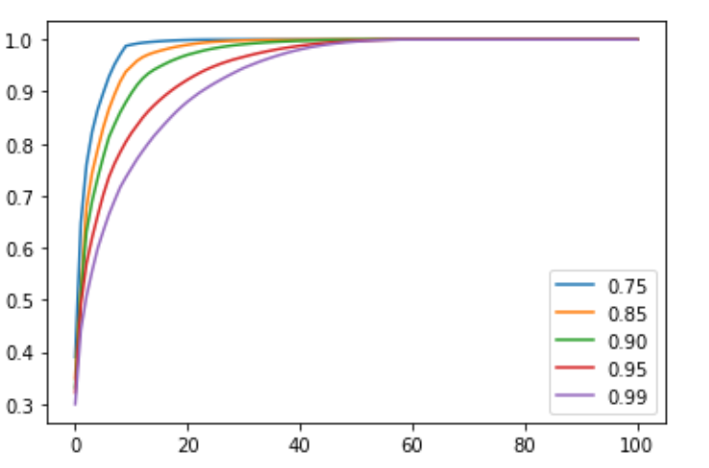
Problem 1
PCA function
Lambda increase, number of eigenvalue included increase
Lambda increase, include more recent data

Slide 3
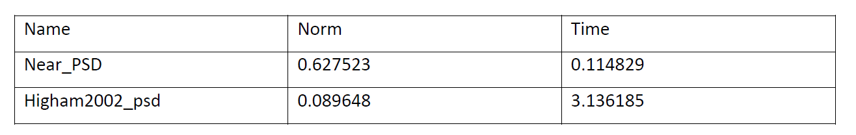
Problem 2
Near_PSD vs Higham 2002
Higham2002 with Higher accurate and more running time
If running time not important, Higham’s method better

Slide 4
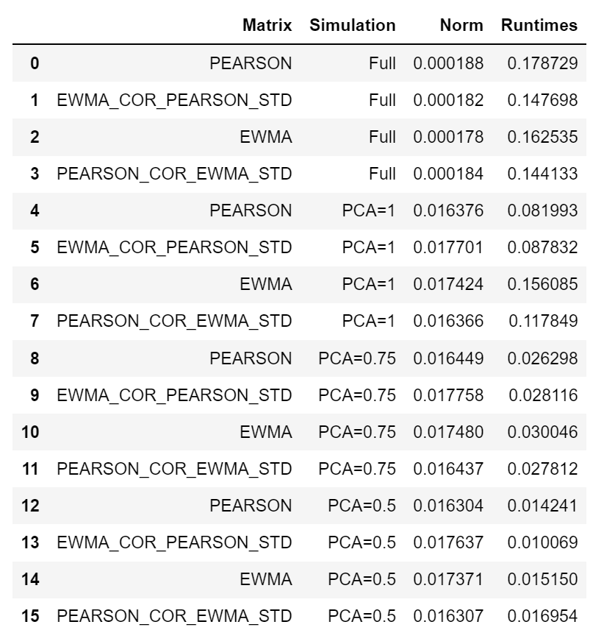
Problem 3
Full vs (100%, 75%, 50%)
Percentage decrease, running time decrease, less accuracy

